Slide 1
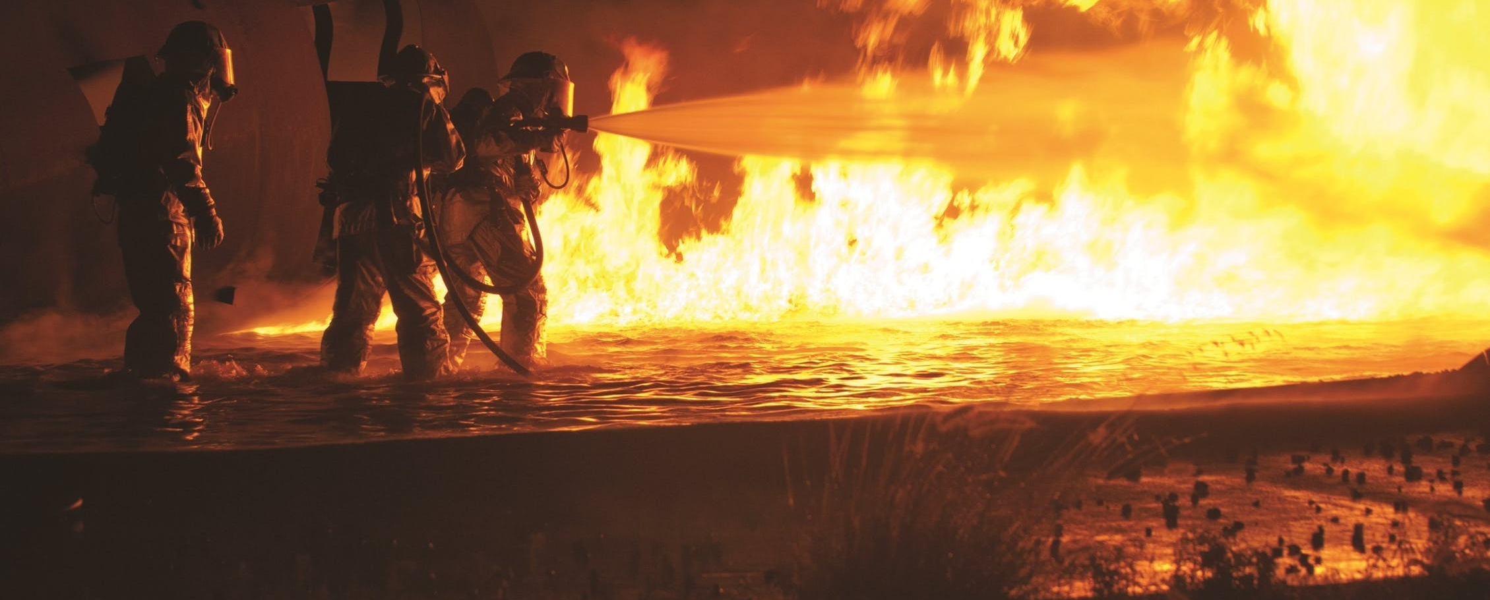
Nature of Risks to be managed…
SEE – Social, Environmental and Economic Impacts of Bushfires

Slide 2
Recall some Social, Environmental and Economic Impacts of Bushfires
Social | Environmental | Economic
Loss of life Physical injuries such as burns and respiratory infections Psychological trauma Brings the community together Loss of family pets Loss of memorabilia (photos) | Damage to the physical environment Loss of habitat for animals Loss of vegetation Air pollution Soils can improve* Native plants will activates germinate | Monetary costs Costs to repair damaged infrastructure Damage to goods and capital belonging to primary producers Damage to settlements Loss of jobs Economic Hardship Costs to fight the fire

Slide 3

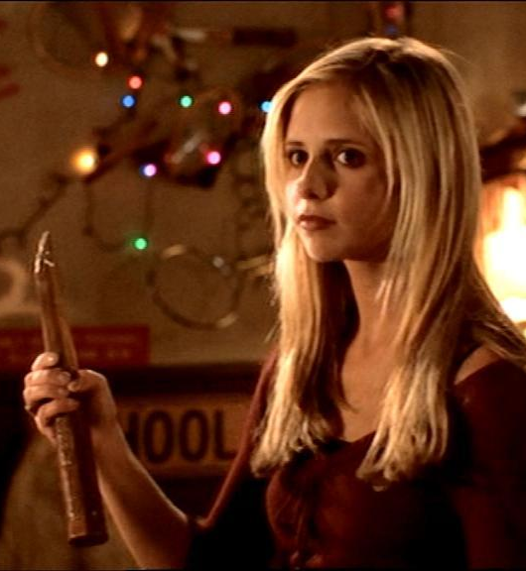
What is a stakeholder?

Slide 4
Stakeholder
A stakeholder is either an individual, group or organisation who is impacted by the outcome of an event. They have an interest in the event.
List some examples of stakeholders of a bushfire event:

Slide 5
Stakeholder
A stakeholder is either an individual, group or organisation who is impacted by the outcome of an event. They have an interest in the event.
List some examples of stakeholders of a bushfire event:
Local residents, the affected community, volunteer firefighters, ancillary organisations (Red Cross), DFES, Department of Biodiversity, Conservation and Attractions, Parks and Wildlife, Police, Ambulance, Media, Surrounding Towns, RSPCA

